Slide 1

Welcome!
FLTC was established during a T.A.S.K. Ministries’ apostolic territorial insertion in Northern KY that expanded into an 18-month teaching assignment. This resulted in establishing a training center in 2018 purposed to equip the Body of Christ according to the purpose, call and destiny ordained by God.
Let’s be clear! The focus of Fivefold Leadership Training Center has been to bring teaching and training to ALL who understand the need for becoming the most effective apostle, prophet, evangelist, pastor or teacher, leader, intercessor, psalmist, and a believer who is seeking personal spiritual growth or discipleship!
To guarantee affordability for its students, FLTC curriculums are designed for optimum learning from the novice level to the advanced student levels without being an accredited Bible School. Instructors are local and extend to Illinois, Florida, and Kentucky,
There is a class for everyone, so scroll down and choose something new to learn! Set up a personal login, register with your credit card 24/7... any time when it’s convenient for you, download the materials, watch for your confirmation email and Zoom invitation, calendar your class and prepare to receive biblically-supported teaching, training and equipping!
As an added benefit, a discount will be applied when registering for two classes or more and automatically calculated at checkout. Just insert CLASS2.
FLTC looks forward to being a part of preparing you for your purpose, call and destiny!

Slide 2
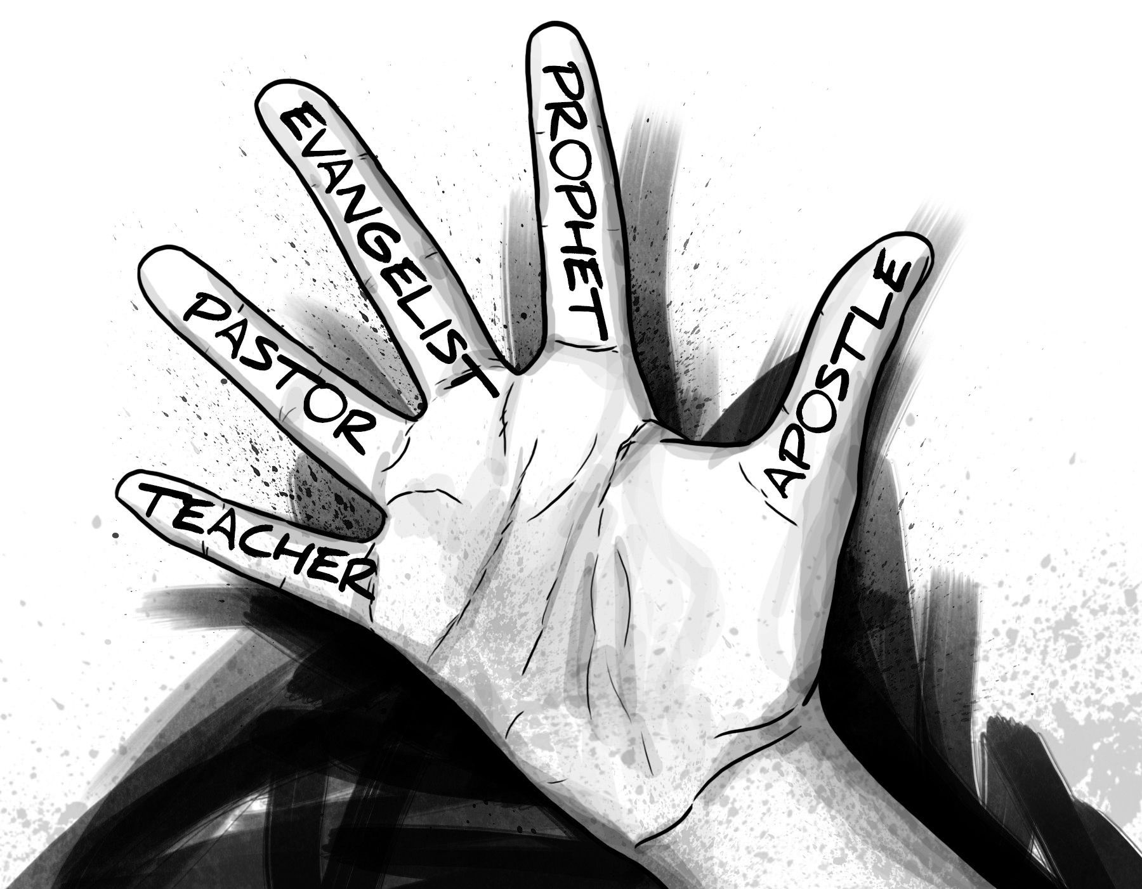
BROWSE CLASS CATEGORIES
PASTOR/TEACHER
FAITH & KINGDOM
OLD TESTAMENT STUDIES
RECOVERY
LEADERSHIP
SPIRITUAL WARFARE 1 & 2
CHURCH ORGANIZATION
WEBINAR COACHING SERIES
INTRODUCTION TO FIVEFOLD MINISTRY
APOSTLE
PROPHET
EVANGELIST

Slide 3
BROWSE ALL CLASSES
INTRODUCTION TO FIVEFOLD MINISTRY
What is the Ascension Fivefold Ministry
Apostolic vs. Ascension Fivefold
Where Do You Fit?
PASTOR/TEACHER
Introduction to the Pastor/Teacher
The Function of the Pastor
Preparing to Pastor
Office of the Pastor
Pastor Shift to Prophet
Pastor Shift to Apostle
LEADERSHIP
Developing the Leader Within You
Leadership Bootcamp
Preparing for Ministry
WEBINAR COACHING SERIES
Series 1 – Apostle
Series 2 – Prophet
Series 3 – Evangelist
Series 4 – Pastor
Series 5 – Faith & Kingdom
Series 6 – Leadership
Series 7 – OT Studies
Series 8 – Recovery
Series 9 – Spiritual Warfare 1
Series 10 – Spiritual Warfare 2
APOSTLE
Introduction to the Apostle
Moving into the Apostolic
Walking in the Apostleship
Apostle and Prophet Covenant
Office of the Apostle
SPIRITUAL WARFARE
Spiritual Warfare Firepower
Spiritual Warfare Master Class
The Strongman
FAITH & KINGDOM
Foundations of Christian Doctrines
The Invisible King and His Kingdom
PROPHET
Introduction to the Prophet
Prophetic Protocol and Order
The Function of the Prophet
Identifying the True Prophet
Types of Prophets and Their Assignments
Office of the Prophet
CHURCH ORGANIZATION
Organizing Your Ministry w/State
Becoming a 501(c)3
Policies & Procedures
OLD TESTAMENT STUDIES
Introduction to the Bible
Jacob’s Wells
The Tabernacle of Moses
EVANGELIST
Introduction to the Evangelist
The Function of the Evangelist
Evangelist or Pastor?
The Evangelist and Spiritual Warfare
Office of the Evangelist
RECOVERY
Co-Dependency Part 1
Co-Dependency Part 2
Healing the Exploited Woman

